Slide 1
CSE450
Data Mining
Week 5:
  Naïve Baysean Classifier

Slide 2

Naïve Bayes Classifier
Thomas Bayes
1702 - 1761
We will start off with a visual intuition, before looking at the math…

Slide 3

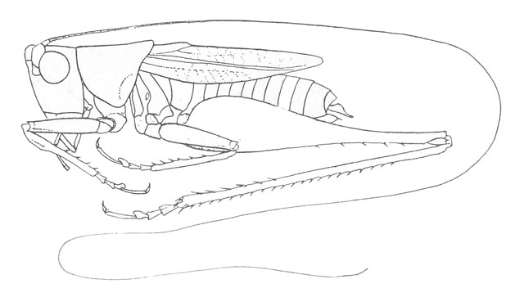
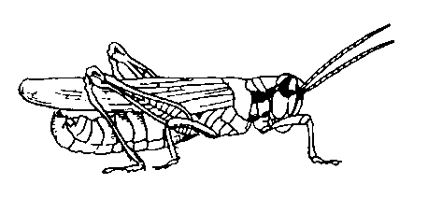
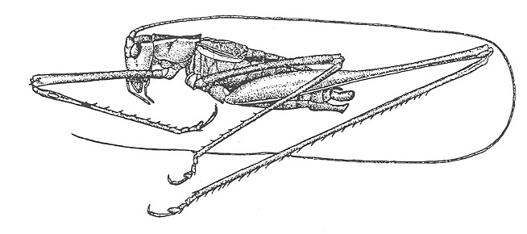
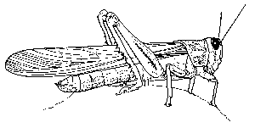
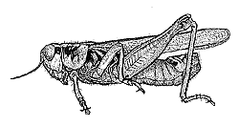
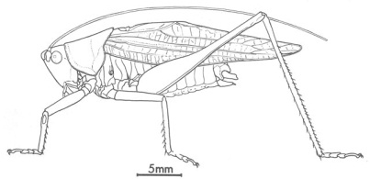
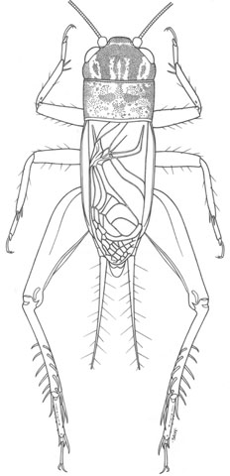
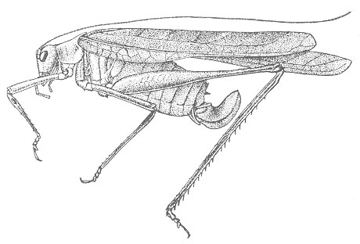
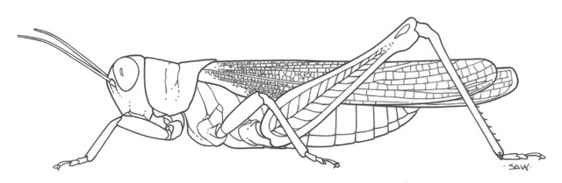
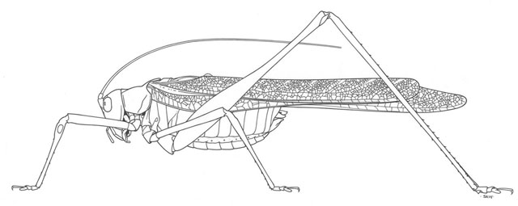
Grasshoppers
Katydids
10
9
8
7
6
Antenna Length
5
4
3
2
1
1
2
3
4
5
6
7
8
9
10
Abdomen Length
Remember this example? Let’s get lots more data…

Slide 4
With a lot of data, we can build a histogram. Let us just build one for “Antenna Length” for now…
10
9
8
7
6
Antenna Length
5
4
3
2
1
1
2
3
4
5
6
7
8
9
10
Katydids
Grasshoppers

Slide 5
We can leave the histograms as they are, or we can summarize them with two normal distributions.
Let us us two normal distributions for ease of visualization in the following slides…

Slide 6
We want to classify an insect we have found. Its antennae are 3 units long. How can we classify it?
We can just ask ourselves, give the distributions of antennae lengths we have seen, is it more probable that our insect is a Grasshopper or a Katydid.
There is a formal way to discuss the most probable classification…
p(c_{j} | d) = probability of class c_{j}, given that we have observed d
3
Antennae length is 3

Slide 7
p(c_{j} | d) = probability of class c_{j}, given that we have observed d
P(Grasshopper | 3 ) = 10 / (10 + 2) = 0.833
P(Katydid | 3 ) = 2 / (10 + 2) = 0.166
10
2
3
Antennae length is 3

Slide 8
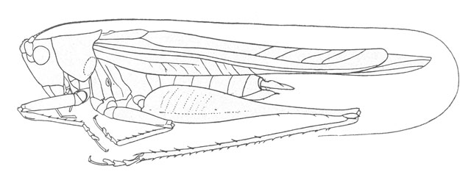
p(c_{j} | d) = probability of class c_{j}, given that we have observed d
P(Grasshopper | 7 ) = 3 / (3 + 9) = 0.250
P(Katydid | 7 ) = 9 / (3 + 9) = 0.750
9
3
7
Antennae length is 7

Slide 9
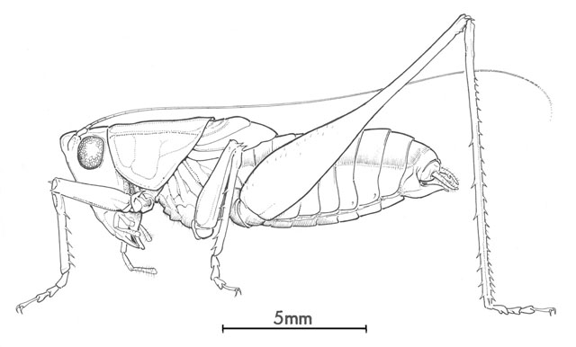
p(c_{j} | d) = probability of class c_{j}, given that we have observed d
P(Grasshopper | 5 ) = 6 / (6 + 6) = 0.500
P(Katydid | 5 ) = 6 / (6 + 6) = 0.500
6
6
5
Antennae length is 5

Slide 10
Bayes Classifiers
That was a visual intuition for a simple case of the Bayes classifier, also called:
  Idiot Bayes
  Naïve Bayes
  Simple Bayes
We are about to see some of the mathematical formalisms, and more examples, but keep in mind the basic idea.
Find out the probability of the previously unseen instance belonging to each class, then simply pick the most probable class.

Slide 11
Bayesian Classifiers
Bayesian classifiers use Bayes theorem, which says
p(c_{j} | d ) = p(d | c_{j} ) p(c_{j})
p(d)
p(c_{j} | d) = probability of instance d being in class c_{j},
This is what we are trying to compute
p(d | c_{j}) = probability of generating instance d given class c_{j},
We can imagine that being in class c_{j}, causes you to have feature d with some probability
p(c_{j}) = probability of occurrence of class c_{j},
This is just how frequent the class c_{j}, is in our database
p(d) = probability of instance d occurring
This can actually be ignored, since it is the same for all classes

Slide 12
Bayesian Classifiers
Given a record with attributes (A₁, A₂,…,A_{n})
  The goal is to predict class C
  Actually, we want to find the value of C that maximizes P(C| A₁, A₂,…,A_{n} )
Can we estimate P(C| A₁, A₂,…,A_{n} ) directly (w/o Bayes)?
  Yes, we simply need to count up the number of times we see A₁, A₂,…,A_{n} and then see what fraction belongs to each class
  For example, if n=3 and the feature vector “4,3,2” occurs 10 times and 4 of these belong to C1 and 6 to C2, then:
    What is P(C1|”4,3,2”)?
    What is P(C2|”4,3,2”)?
Unfortunately, this is generally not feasible since not every feature vector will be found in the training set (remember the crime scene analogy from the previous lecture?)

Slide 13
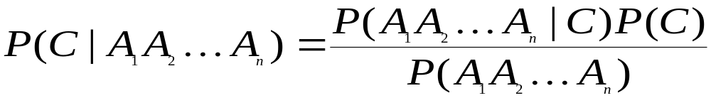
Bayesian Classifiers
Indirect Approach: Use Bayes Theorem
  compute the posterior probability P(C | A₁, A₂, …, A_{n}) for all values of C using the Bayes theorem
  Choose value of C that maximizes P(C | A₁, A₂, …, A_{n})
  Equivalent to choosing value of C that maximizes
  P(A₁, A₂, …, A_{n}|C) P(C)
    Since the denominator is the same for all values of C

Slide 14
Naïve Bayes Classifier
How can we estimate P(A₁, A₂, …, A_{n} |C)?
  We can measure it directly, but only if the training set samples every feature vector. Not practical!
So, we must assume independence among attributes A_{i} when class is given:
  P(A₁, A₂, …, A_{n} |C) = P(A₁| C_{j}) P(A₂| C_{j})… P(A_{n}| C_{j})
  Then we can estimate P(A_{i}| C_{j}) for all A_{i} and C_{j} from training data
    This is reasonable because now we are looking only at one feature at a time. We can expect to see each feature value represented in the training data.
New point is classified to C_{j} if P(C_{j}) Π P(A_{i}| C_{j}) is maximal.

Slide 15
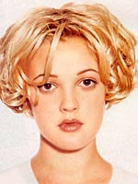

Assume that we have two classes
c₁ = male, and c₂ = female.
We have a person whose sex we do not know, say “drew” or d.
Classifying drew as male or female is equivalent to asking is it more probable that drew is male or female, I.e which is greater p(male | drew) or p(female | drew)
(Note: “Drew can be a male or female name”)
Drew Barrymore
Drew Carey
What is the probability of being called “drew” given that you are a male?
What is the probability of being a male?
p(male | drew) = p(drew | male ) p(male)
p(drew)
What is the probability of being named “drew”? (actually irrelevant, since it is that same for all classes)

Slide 16
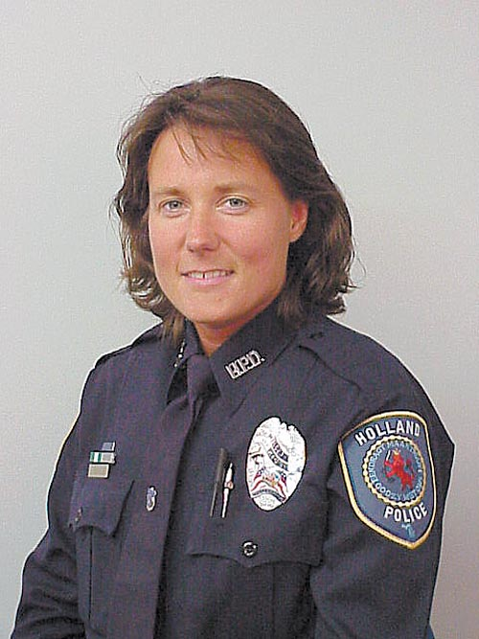
This is Officer Drew (who arrested me in 1997). Is Officer Drew a Male or Female?
Luckily, we have a small database with names and sex.
We can use it to apply Bayes rule…
Name | Sex
Drew | Male
Claudia | Female
Drew | Female
Drew | Female
Alberto | Male
Karin | Female
Nina | Female
Sergio | Male
Officer Drew
p(c_{j} | d) = p(d | c_{j} ) p(c_{j}) p(d)

Slide 17
Name | Sex
Drew | Male
Claudia | Female
Drew | Female
Drew | Female
Alberto | Male
Karin | Female
Nina | Female
Sergio | Male
p(c_{j} | d) = p(d | c_{j} ) p(c_{j}) p(d)
Officer Drew
p(male | drew) = 1/3 * 3/8 = 0.125
3/8 3/8
Officer Drew is more likely to be a Female.
p(female | drew) = 2/5 * 5/8 = 0.250
3/8 3/8

Slide 18
Officer Drew IS a female!
So far we have only considered Bayes Classification when we have one attribute (the “antennae length”, or the “name”). But we may have many features.
How do we use all the features?
Officer Drew
p(male | drew) = 1/3 * 3/8 = 0.125
3/8 3/8
p(female | drew) = 2/5 * 5/8 = 0.250
3/8 3/8

Slide 19
p(c_{j} | d) = p(d | c_{j} ) p(c_{j}) p(d)
Name | Over 170CM | Eye | Hair length | Sex
Drew | No | Blue | Short | Male
Claudia | Yes | Brown | Long | Female
Drew | No | Blue | Long | Female
Drew | No | Blue | Long | Female
Alberto | Yes | Brown | Short | Male
Karin | No | Blue | Long | Female
Nina | Yes | Brown | Short | Female
Sergio | Yes | Blue | Long | Male

Slide 20
To simplify the task, naïve Bayesian classifiers assume attributes have independent distributions, and thereby estimate
p(d|c_{j}) = p(d₁|c_{j}) * p(d₂|c_{j}) * ….* p(d_{n}|c_{j})
The probability of class c_{j} generating instance d, equals….
The probability of class c_{j} generating the observed value for feature 1, multiplied by..
The probability of class c_{j} generating the observed value for feature 2, multiplied by..

Slide 21

To simplify the task, naïve Bayesian classifiers assume attributes have independent distributions, and thereby estimate
p(d|c_{j}) = p(d₁|c_{j}) * p(d₂|c_{j}) * ….* p(d_{n}|c_{j})
  p(officer drew|c_{j}) = p(over_170_{cm} = yes|c_{j}) * p(eye =blue|c_{j}) * ….
Officer Drew is blue-eyed, over 170_{cm} tall, and has long hair
  p(officer drew| Female) = 2/5 * 3/5 * ….
  p(officer drew| Male) = 2/3 * 2/3 * ….

Slide 22
c_{j}
The Naive Bayes classifiers is often represented as this type of graph…
Note the direction of the arrows, which state that each class causes certain features, with a certain probability
…
  p(d₁|c_{j}) p(d₂|c_{j}) p(d_{n}|c_{j})

Slide 23
c_{j}
Naïve Bayes is fast and space efficient
We can look up all the probabilities with a single scan of the database and store them in a (small) table…
…
  p(d₁|c_{j}) p(d₂|c_{j}) p(d_{n}|c_{j})
Sex | Over190_{cm}
Male | Yes | 0.15
 | No | 0.85
Female | Yes | 0.01
 | No | 0.99
Sex | Long Hair
Male | Yes | 0.05
 | No | 0.95
Female | Yes | 0.70
 | No | 0.30
Sex
Male
Female

Slide 24
Naïve Bayes is NOT sensitive to irrelevant features...
Suppose we are trying to classify a persons sex based on several features, including eye color. (Of course, eye color is completely irrelevant to a persons gender)
  p(Jessica |c_{j}) = p(eye = brown|c_{j}) * p( wears_dress = yes|c_{j}) * ….
  p(Jessica | Female) = 9,000/10,000 * 9,975/10,000 * ….
  p(Jessica | Male) = 9,001/10,000 * 2/10,000 * ….
Almost the same!
However, this assumes that we have good enough estimates of the probabilities, so the more data the better.

Slide 25
c_{j}
An obvious point. I have used a simple two class problem, and two possible values for each example, for my previous examples. However we can have an arbitrary number of classes, or feature values
…
  p(d₁|c_{j}) p(d₂|c_{j}) p(d_{n}|c_{j})
Animal | Mass >10_{kg}
Cat | Yes | 0.15
 | No | 0.85
Dog | Yes | 0.91
 | No | 0.09
Pig | Yes | 0.99
 | No | 0.01
Animal | Color
Cat | Black | 0.33
 | White | 0.23
 | Brown | 0.44
Dog | Black | 0.97
 | White | 0.03
 | Brown | 0.90
Pig | Black | 0.04
 | White | 0.01
 | Brown | 0.95
Animal
Cat
Dog
Pig

Slide 26
Naïve Bayesian Classifier
Problem!
Naïve Bayes assumes independence of features…
p(d|c_{j})
  p(d₁|c_{j}) p(d₂|c_{j}) p(d_{n}|c_{j})
Sex | Over 6 foot
Male | Yes | 0.15
 | No | 0.85
Female | Yes | 0.01
 | No | 0.99
Sex | Over 200 pounds
Male | Yes | 0.11
 | No | 0.80
Female | Yes | 0.05
 | No | 0.95

Slide 27
Naïve Bayesian Classifier
Solution
Consider the relationships between attributes…
p(d|c_{j})
  p(d₁|c_{j}) p(d₂|c_{j}) p(d_{n}|c_{j})
Sex | Over 6 foot
Male | Yes | 0.15
 | No | 0.85
Female | Yes | 0.01
 | No | 0.99
Sex | Over 200 pounds
Male | Yes and Over 6 foot | 0.11
 | No and Over 6 foot | 0.59
 | Yes and NOT Over 6 foot | 0.05
 | No and NOT Over 6 foot | 0.35
Female | Yes and Over 6 foot | 0.01

Slide 28
Naïve Bayesian Classifier
Solution
Consider the relationships between attributes…
p(d|c_{j})
  p(d₁|c_{j}) p(d₂|c_{j}) p(d_{n}|c_{j})
But how do we find the set of connecting arcs??

Slide 29
The Naïve Bayesian Classifier
has a quadratic decision boundary
10
9
8
7
6
5
4
3
2
1
1
2
3
4
5
6
7
8
9
10

Slide 30
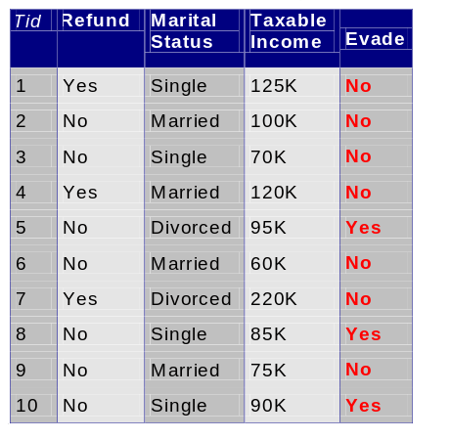
How to Estimate
Probabilities from Data?
Class: P(C) = N_{c}/N
  e.g., P(No) = 7/10,
  P(Yes) = 3/10
  For discrete attributes:
  P(A_{i} | C_{k}) = |A_{ik}|/ N_{c}
  where |A_{ik}| is number of instances having attribute A_{i} and belongs to class C_{k}
  Examples:
  P(Status=Married|No) = 4/7
  P(Refund=Yes|Yes)=0
k

Slide 31
How to Estimate
Probabilities from Data?
For continuous attributes:
  Discretize the range into bins
  Two-way split: (A < v) or (A > v)
    choose only one of the two splits as new attribute
    Creates a binary feature
  Probability density estimation:
    Assume attribute follows a normal distribution and use the data to fit this distribution
    Once probability distribution is known, can use it to estimate the conditional probability P(A_{i}|c)
We will not deal with continuous values on HW or exam
  Just understand the general ideas above
  For the example tax cheating example, we will assume that “Taxable Income” is discrete
    Each of the 10 values will therefore have a prior probability of 1/10
k

Slide 32
Example of Naïve Bayes
We start with a test example and want to know its class. Does this individual evade their taxes: Yes or No?
  Here is the feature vector:
    Refund = No, Married, Income = 120K
  Now what do we do?
    First try writing out the thing we want to measure

Slide 33
Example of Naïve Bayes
We start with a test example and want to know its class. Does this individual evade their taxes: Yes or No?
  Here is the feature vector:
    Refund = No, Married, Income = 120K
  Now what do we do?
    First try writing out the thing we want to measure
    P(Evade|[No, Married, Income=120K])
  Next, what do we need to maximize?

Slide 34
Example of Naïve Bayes
We start with a test example and want to know its class. Does this individual evade their taxes: Yes or No?
  Here is the feature vector:
    Refund = No, Married, Income = 120K
  Now what do we do?
    First try writing out the thing we want to measure
    P(Evade|[No, Married, Income=120K])
  Next, what do we need to maximize?
    P(C_{j}) Π P(A_{i}| C_{j})

Slide 35
Example of Naïve Bayes
Since we want to maximize P(C_{j}) Π P(A_{i}| C_{j})
  What quantities do we need to calculate in order to use this equation?
  Someone come up to the board and write them out, without calculating them
    Recall that we have three attributes:
      Refund: Yes, No
      Marital Status: Single, Married, Divorced
      Taxable Income: 10 different “discrete” values
    While we could compute every P(A_{i}| C_{j}) for all A_{i,} we only need to do it for the attribute values in the test example

Slide 36
Values to Compute
Given we need to compute P(C_{j}) Π P(A_{i}| C_{j})
We need to compute the class probabilities
  P(Evade=No)
  P(Evade=Yes)
We need to compute the conditional probabilities
  P(Refund=No|Evade=No)
  P(Refund=No|Evade=Yes)
  P(Marital Status=Married|Evade=No)
  P(Marital Status=Married|Evade=Yes)
  P(Income=120K|Evade=No)
  P(Income=120K|Evade=Yes)

Slide 37
Computed Values
Given we need to compute P(C_{j}) Π P(A_{i}| C_{j})
We need to compute the class probabilities
  P(Evade=No) = 7/10 = .7
  P(Evade=Yes) = 3/10 = .3
We need to compute the conditional probabilities
  P(Refund=No|Evade=No) = 4/7
  P(Refund=No|Evade=Yes) 3/3 = 1.0
  P(Marital Status=Married|Evade=No) = 4/7
  P(Marital Status=Married|Evade=Yes) =0/3 = 0
  P(Income=120K|Evade=No) = 1/7
  P(Income=120K|Evade=Yes) = 0/7 = 0

Slide 38
Finding the Class
Now compute P(C_{j}) Π P(A_{i}| C_{j}) for both classes for the test example [No, Married, Income = 120K]
  For Class Evade=No we get:
    .7 x 4/7 x 4/7 x 1/7 = 0.032
  For Class Evade=Yes we get:
    .3 x 1 x 0 x 0 = 0
  Which one is best?
    Clearly we would select “No” for the class value
    Note that these are not the actual probabilities of each class, since we did not divide by P([No, Married, Income = 120K])

Slide 39
Naïve Bayes Classifier
If one of the conditional probability is zero, then the entire expression becomes zero
  This is not ideal, especially since probability estimates may not be very precise for rarely occurring values
  We use the Laplace estimate to improve things. Without a lot of observations, the Laplace estimate moves the probability towards the value assuming all classes equally likely
  Solution → smoothing

Slide 40
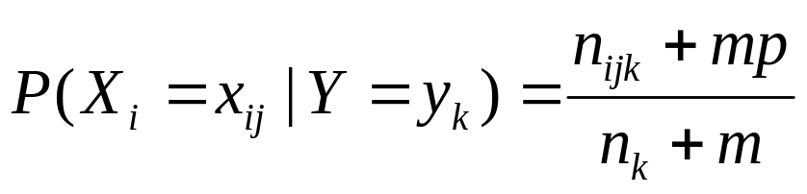
Smoothing
To account for estimation from small samples, probability estimates are adjusted or smoothed.
Laplace smoothing using an m-estimate assumes that each feature is given a prior probability, p, that is assumed to have been previously observed in a “virtual” sample of size m.
For binary features, p is simply assumed to be 0.5.

Slide 41
Laplace Smothing Example
Assume training set contains 10 positive examples:
  4: small
  0: medium
  6: large
Estimate parameters as follows (if m=1, p=1/3)
  P(small | positive) = (4 + 1/3) / (10 + 1) = 0.394
  P(medium | positive) = (0 + 1/3) / (10 + 1) = 0.03
  P(large | positive) = (6 + 1/3) / (10 + 1) = 0.576
  P(small or medium or large | positive) = 1.0

Slide 42
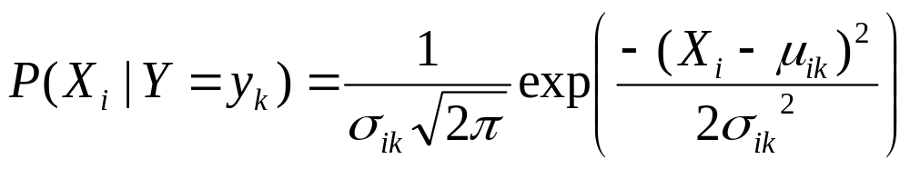
Continuous Attributes
If X_{i} is a continuous feature rather than a discrete one, need another way to calculate P(X_{i} | Y).
Assume that X_{i} has a Gaussian distribution whose mean and variance depends on Y.
During training, for each combination of a continuous feature X_{i} and a class value for Y, y_{k}, estimate a mean, μ_{ik} , and standard deviation σ_{ik} based on the values of feature X_{i} in class y_{k} in the training data.
During testing, estimate P(X_{i} | Y=y_{k}) for a given example, using the Gaussian distribution defined by μ_{ik} and σ_{ik} .

Slide 43
Naïve Bayes (Summary)
Robust to isolated noise points
Robust to irrelevant attributes
Independence assumption may not hold for some attributes
  But works surprisingly well in practice for many problems

Slide 44
More Examples
There are two more examples coming up
  Go over them before trying the HW, unless you are clear on Bayesian Classifiers
You are not responsible for Bayesian Belief Networks

Slide 45
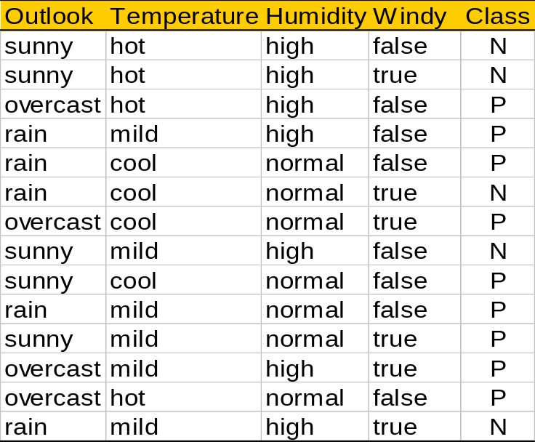
Play-tennis example: estimate P(x_{i}|C)
outlook
P(sunny|p) = 2/9 | P(sunny|n) = 3/5
P(overcast|p) = 4/9 | P(overcast|n) = 0
P(rain|p) = 3/9 | P(rain|n) = 2/5
Temperature
P(hot|p) = 2/9 | P(hot|n) = 2/5
P(mild|p) = 4/9 | P(mild|n) = 2/5
P(cool|p) = 3/9 | P(cool|n) = 1/5
Humidity
P(high|p) = 3/9 | P(high|n) = 4/5
P(normal|p) = 6/9 | P(normal|n) = 2/5
windy
P(true|p) = 3/9 | P(true|n) = 3/5
P(false|p) = 6/9 | P(false|n) = 2/5
P(p) = 9/14
P(n) = 5/14

Slide 46
Play-tennis example: classifying X
An unseen sample X = <rain, hot, high, false>
P(X|p)·P(p) =
P(rain|p)·P(hot|p)·P(high|p)·P(false|p)·P(p) = 3/9·2/9·3/9·6/9·9/14 = 0.010582
P(X|n)·P(n) =
P(rain|n)·P(hot|n)·P(high|n)·P(false|n)·P(n) = 2/5·2/5·4/5·2/5·5/14 = 0.018286
Sample X is classified in class n (don’t play)

Slide 47
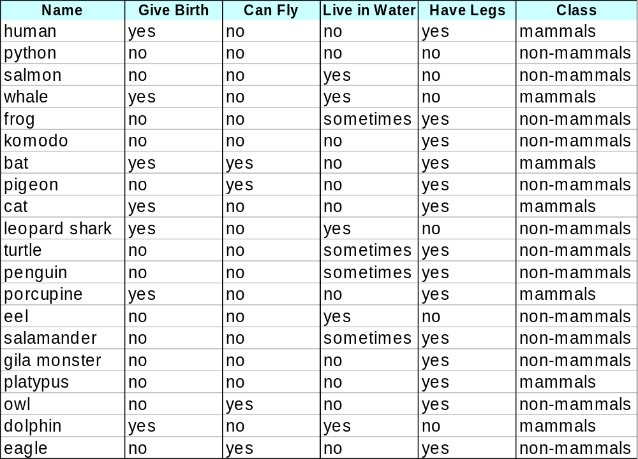
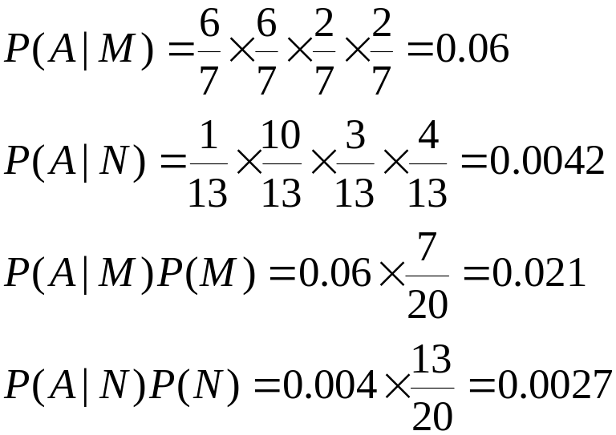
Example of Naïve Bayes Classifier
A: attributes
M: mammals
N: non-mammals
P(A|M)P(M) > P(A|N)P(N)
=> Mammals

Slide 48
Computer Example: Data Table
Rec | Age | Income | Student | Credit_rating | Buys_computer
1 | <=30 | High | No | Fair | No
2 | <=30 | High | No | Excellent | No
3 | 31..40 | High | No | Fair | Yes
4 | >40 | Medium | No | Fair | Yes
5 | >40 | Low | Yes | Fair | Yes
6 | >40 | Low | Yes | Excellent | No
7 | 31..40 | Low | Yes | Excellent | Yes
8 | <=30 | Medium | No | Fair | No
9 | <=30 | Low | Yes | Fair | Yes
10 | >40 | Medium | Yes | Fair | Yes
11 | <=30 | Medium | Yes | Excellent | Yes
12 | 31..40 | Medium | No | Excellent | Yes
13 | 31..40 | High | Yes | Fair | Yes
14 | >40 | Medium | No | Excellent | No

Slide 49


Computer Example
I am 35-year old
I earn $40,000
My credit rating is fair
Will he buy a computer?
X : 35 years old customer with an income of $40,000 and fair credit rating.
H : Hypothesis that the customer will buy a computer.

Slide 50
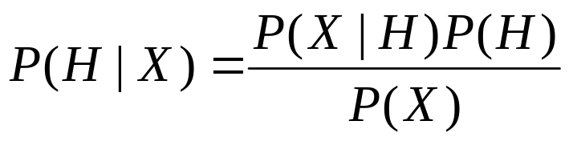
Bayes Theorem
P(H|X) : Probability that the customer will buy a computer given that we know his age, credit rating and income. (Posterior Probability of H)
P(H) : Probability that the customer will buy a computer regardless of age, credit rating, income (Prior Probability of H)
P(X|H) : Probability that the customer is 35 yrs old, have fair credit rating and earns $40,000, given that he has bought our computer (Posterior Probability of X)
P(X) : Probability that a person from our set of customers is 35 yrs old, have fair credit rating and earns $40,000. (Prior Probability of X)

Slide 51
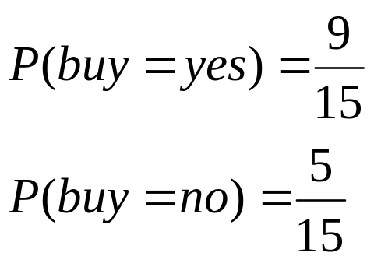
Computer Example: Description
The data samples are described by attributes age, income, student, and credit. The class label attribute, buy, tells whether the person buys a computer, has two distinct values, yes (Class C1) and no (Class C2).
The sample we wish to classify is
  X = (age <= 30, income = medium, student = yes, credit = fair)
We need to maximize P(X|Ci)P(Ci), for i = 1, 2.
P(Ci), the a priori probability of each class, can be estimated based on the training samples:

Slide 52
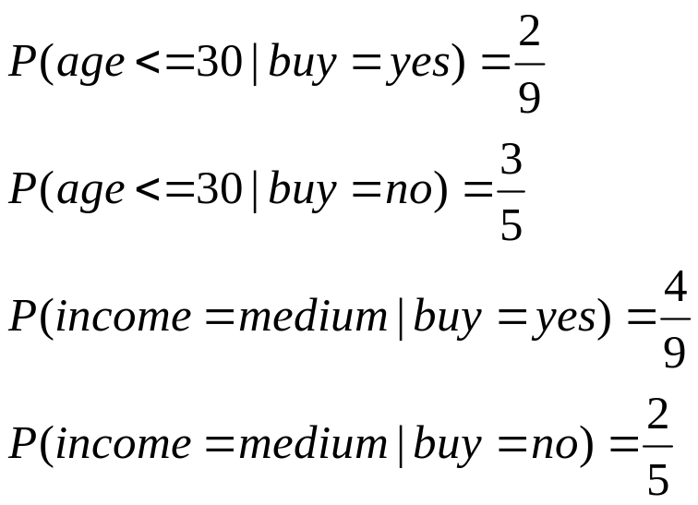
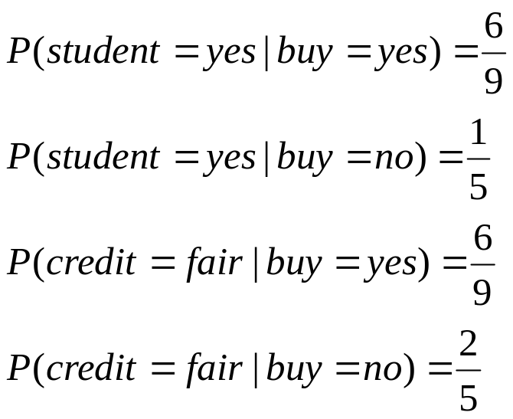
Computer Example: Description
X = (age <= 30, income = medium, student = yes, credit = fair)
To compute P(X|Ci), for i = 1, 2, we compute the following conditional probabilities:

Slide 53
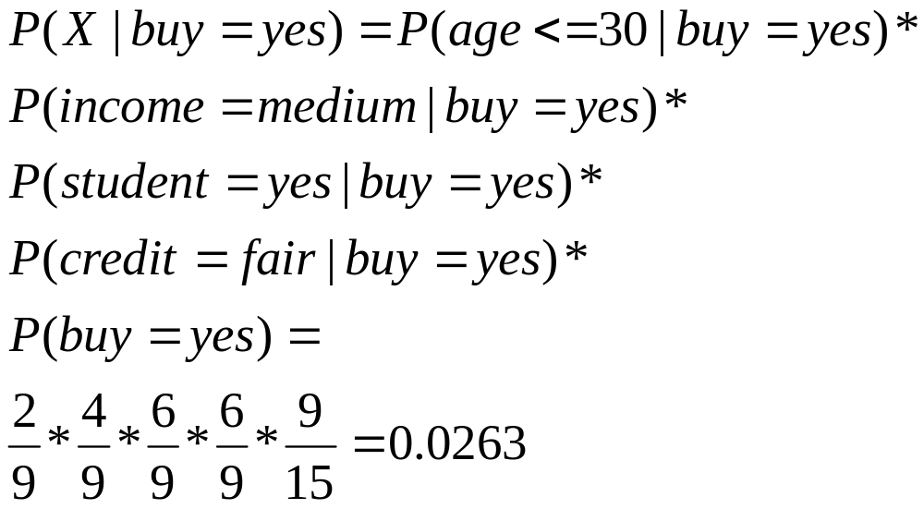
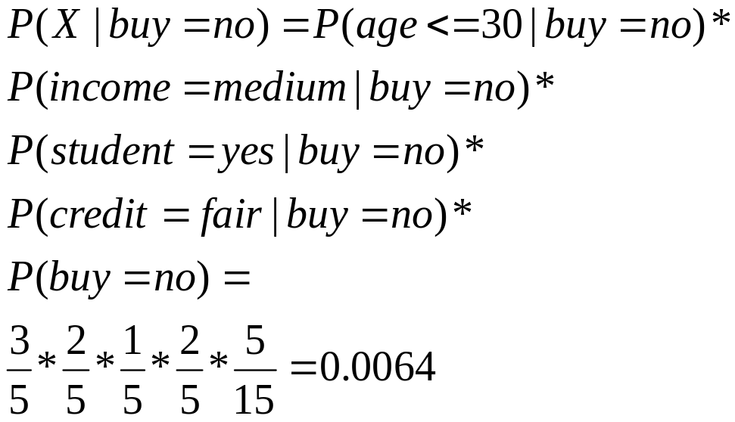
Computer Example: Description
X = (age <= 30, income = medium, student = yes, credit = fair)
Using probabilities from the two previous slides:

Slide 54
Tennis Example 2: Data Table
Rec | Outlook | Temperature | Humidity | Wind | PlayTannis
1 | Sunny | Hot | High | Weak | No
2 | Sunny | Hot | High | Strong | No
3 | Overcast | Hot | High | Weak | Yes
4 | Rain | Mild | High | Weak | Yes
5 | Rain | Cool | Normal | Weak | Yes
6 | Rain | Cool | Normal | Strong | No
7 | Overcast | Cool | Normal | Strong | Yes
8 | Sunny | Mild | High | Weak | No
9 | Sunny | Cool | Normal | Weak | Yes
10 | Rain | Mild | Normal | Weak | Yes
11 | Sunny | Mild | Normal | Strong | Yes
12 | Overcast | Mild | High | Strong | Yes
13 | Overcast | Hot | Normal | Weak | Yes
14 | Rain | Mild | High | Strong | No

Slide 55
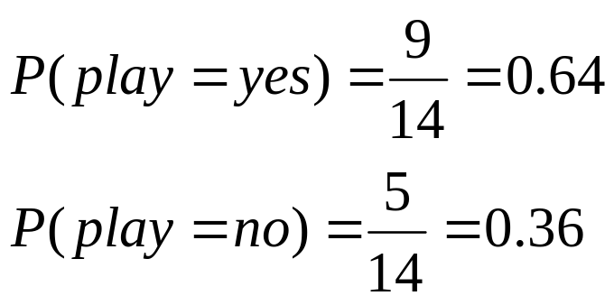
Tennis Example 2: Description
The data samples are described by attributes outlook, temperature, humidity and wind. The class label attribute, PlayTennis, tells whether the person will play tennis or not, has two distinct values, yes (Class C1) and no (Class C2).
The sample we wish to classify is
  X = (outlook=sunny, temperature=cool, humidity = high, wind=strong)
We need to maximize P(X|Ci)P(Ci), for i = 1, 2.
P(Ci), the a priori probability of each class, can be estimated based on the training samples:

Slide 56
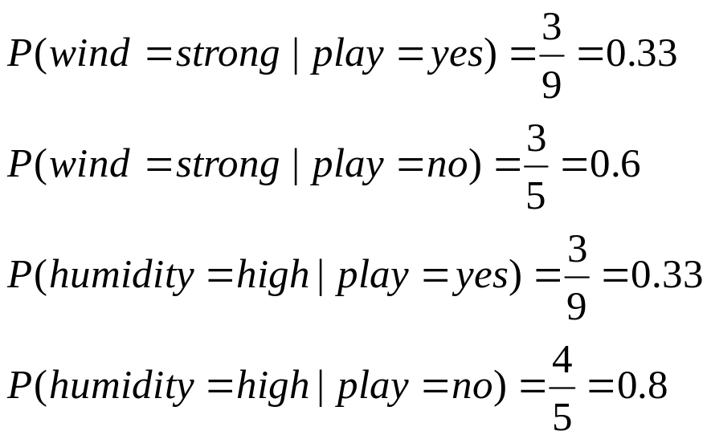
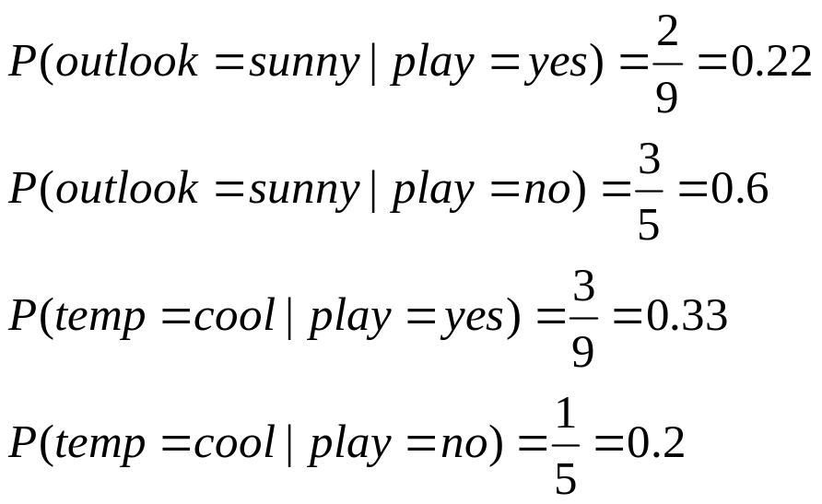
Tennis Example 2: Description
X = (outlook=sunny, temperature=cool, humidity = high, wind=strong)
To compute P(X|Ci), for i = 1, 2, we compute the following conditional probabilities:

Slide 57
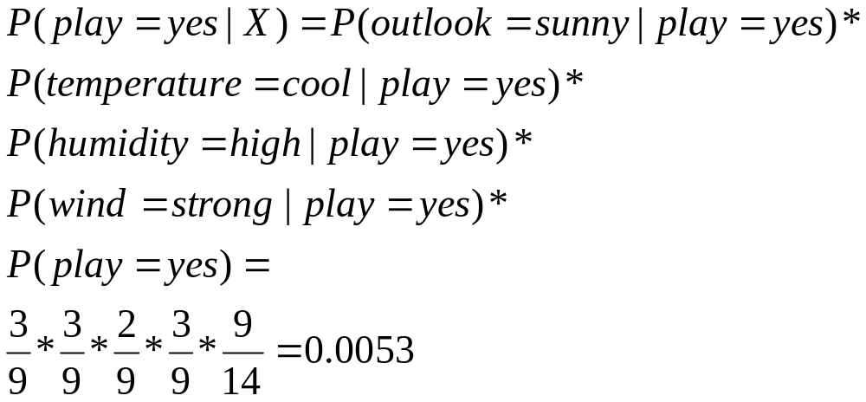
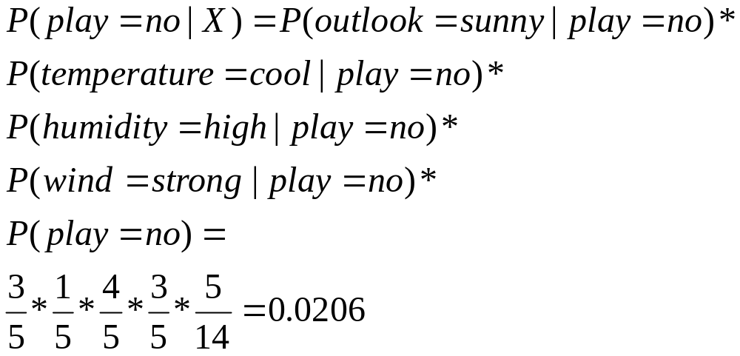
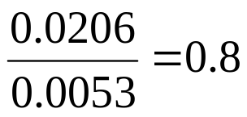
Tennis Example 2: Description
X = (outlook=sunny, temperature=cool, humidity = high, wind=strong)
Using probabilities from the previous two pages we can compute the probability in question:
h_{MAP} is not playing tennis
Normalization:

Slide 58
Dear SIR,
I am Mr. John Coleman and my sister is Miss Rose Colemen, we are the children of late Chief Paul Colemen from Sierra Leone. I am writing you in absolute confidence primarily to seek your assistance to transfer our cash of twenty one Million Dollars ($21,000.000.00) now in the custody of a private Security trust firm in Europe the money is in trunk boxes deposited and declared as family valuables by my late father as a matter of fact the company does not know the content as money, although my father made them to under stand that the boxes belongs to his foreign partner.
…

Slide 59
This mail is probably spam. The original message has been attached along with this report, so you can recognize or block similar unwanted mail in future. See http://spamassassin.org/tag/ for more details.
Content analysis details: (12.20 points, 5 required)
NIGERIAN_SUBJECT2 (1.4 points) Subject is indicative of a Nigerian spam
FROM_ENDS_IN_NUMS (0.7 points) From: ends in numbers
MIME_BOUND_MANY_HEX (2.9 points) Spam tool pattern in MIME boundary
URGENT_BIZ (2.7 points) BODY: Contains urgent matter
US_DOLLARS_3 (1.5 points) BODY: Nigerian scam key phrase ($NN,NNN,NNN.NN)
DEAR_SOMETHING (1.8 points) BODY: Contains 'Dear (something)'
BAYES_30 (1.6 points) BODY: Bayesian classifier says spam probability is 30 to 40%
[score: 0.3728]
Naïve Bayesian is a standard classifier to distinguish between spam and non-spam

Slide 60
Bayesian Classification
  Statistical method for classification.
  Supervised Learning Method.
  Assumes an underlying probabilistic model, the Bayes theorem.
  Can solve diagnostic and predictive problems.
  Can solve problems involving both categorical and continuous valued attributes.
  Particularly suited when the dimensionality of the input is high
  In spite of the over-simplified assumption, it often performs better in many complex real-world situations
  Advantage: Requires a small amount of training data to estimate the parameters

Slide 61
Advantages/Disadvantages
of Naïve Bayes
Advantages:
  Fast to train (single scan). Fast to classify
  Not sensitive to irrelevant features
  Handles real and discrete data
  Handles streaming data well
Disadvantages:
  Assumes independence of features

